Slide 1
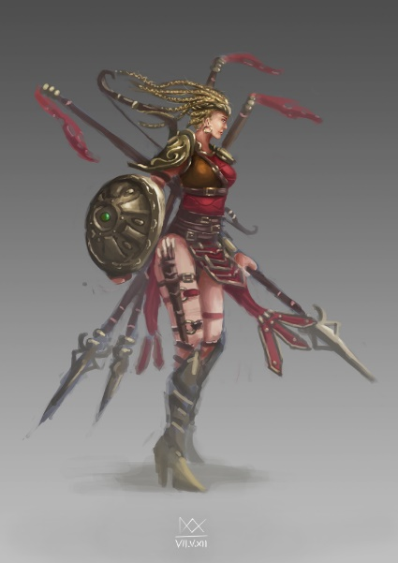



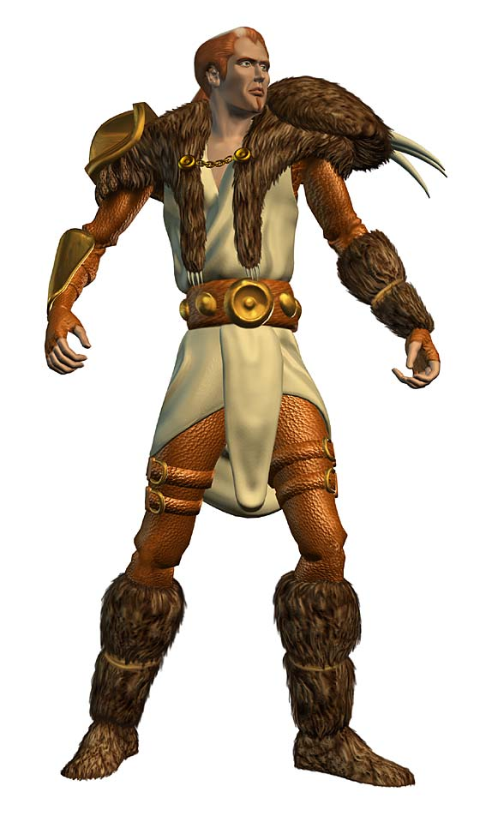
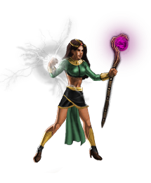

Character classes (Diablo II)
Notes:
Classes is a collective name for the seven playable characters available to the player in Diablo II and the expansion Diablo II: Lord of Destruction. Each class features a different model and animations, speech, skill set and breakpoints
Amazon
Assassin
Barbarian
Druid
Necromancer
Paladin
Sorceress

Slide 2
Social classes
Common three-stratum model
Upper
Middle
Lower

Slide 3
Biological classes
Mammalia
Aves
Reptilia
Notes:
taxonomic grouping of related organisms

Slide 4
Java: constructors

Slide 5
Objectives
Understand how we create objects in Java
Practice your algorithm design skills
Practice translating your algorithm into a Java program

Slide 6
Object creation
Objects exist, but not until we make them so
We say that we instantiate a class to create an object
Put another way, an object is an instance of a class
Notes:
Instance – a particular occurrence of something

Slide 7
Constructors
Constructors are the Java mechanism that allows us to create objects
Constructors are methods
Methods that give an initial state to a new object
Examples so far: new GLabel()
Accessed using the new keyword
Notes:
State – a manner or condition of being

Slide 8
Demonstration
Notes:
Walk through the Paladin.java and DiabloII.java files describing the purpose of constructors
Discuss method signatures

Slide 9
Practice
Copy the Java files “Paladin.java” and “DiabloII.java” from /usr/people/classes/CS160 directory to your CS160 directory
Create a new class modeled after the Paladin character class which represents the Sorceress character class
Add a field “level”, representing the characters skill level to both classes
The field “level” should be given an initial value of 0 in the constructor
Add a method “getLevel()” to the Paladin and Sorceress classes and use it to print the characters levels along with their names
Notes:
What type will field “level” have?
What type will the method “getLevel()” return?

